Slide 1
Memory

Slide 2
Introduction
Memory
information storage
a collection of cells store binary information
ROM – Read-Only Memory
read operation only
a programmable logic device
RAM – Random-Access Memory
read operation
write operation
2
Notes:
credential:
bring a computer
die photo
wafer
:
This can be an hidden slide. I just want to use this to do my own planning.
I have rearranged Culler’s lecture slides slightly and add more slides. This covers everything he covers in his first lecture (and more) but may
We will save the fun part, “ Levels of Organization,” at the end (so student can stay awake): I will show the internal stricture of the SS10/20.
Notes to Patterson: You may want to edit the slides in your section or add extra slides to taylor your needs.

Slide 3
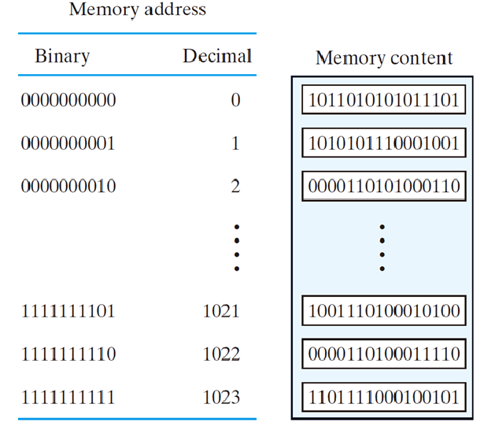
Introduction
If memory has 2^{k} words, k address bits are needed
2³ words, 3 address bits
Address locations are labeled 0 to 2^{k}-1
Common subscripts:
Kilo – 2¹⁰
Mega – 2²⁰
Giga - 2³⁰
3

Slide 4
Introduction
1M bits
( 2²⁰x1 = 2¹⁷x8 )
1-bit
1M bits
= 128 KB
8-bit
20
address lines
17
address lines
2¹⁷
memory cells
2²⁰ memory cells
8-bit
1-bit
4

Slide 5
Read-Only Memory

Slide 6
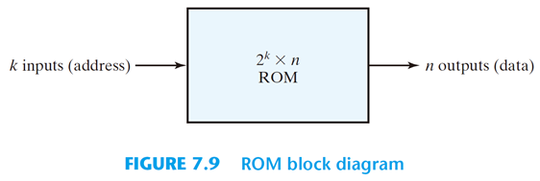
Read-Only Memory (ROM)
ROMs store permanent binary information
ROMs are effective at implementing truth tables
Any logic function can be implemented using ROMs
Also used in computer systems for initialization
ROM doesn’t lose storage value when power is removed
Very useful for implementing FSMs
2^{k} x n ROM
k address input lines
enable input(s)
three-state outputs
6
Notes:
credential:
bring a computer
die photo
wafer
:
This can be an hidden slide. I just want to use this to do my own planning.
I have rearranged Culler’s lecture slides slightly and add more slides. This covers everything he covers in his first lecture (and more) but may
We will save the fun part, “ Levels of Organization,” at the end (so student can stay awake): I will show the internal stricture of the SS10/20.
Notes to Patterson: You may want to edit the slides in your section or add extra slides to taylor your needs.

Slide 7
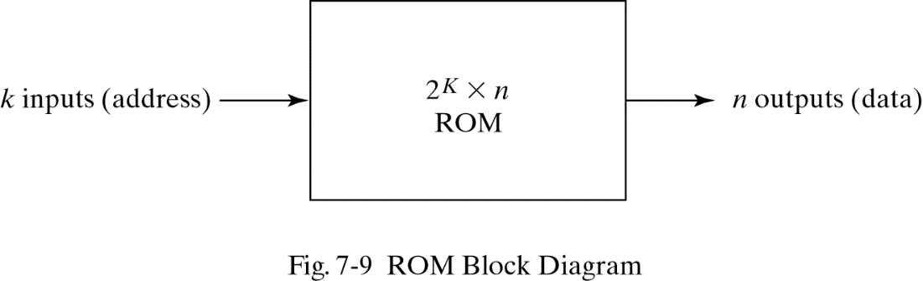
ROM Structure
k Inputs
k x 2^{k}
decoder
Memory Array
2^{k} words x n bits
.
.
.
.
.
.
...
n Outputs Lines
7

Slide 8
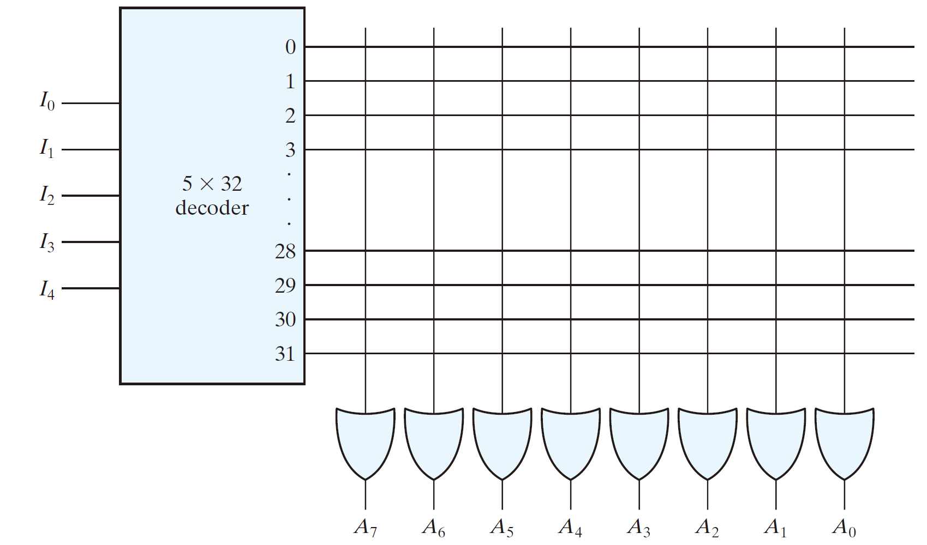
A 32 x 8 ROM
5-to-32 decoder
8 OR gates
each has 32 inputs
32x8 internal programmable connections
8

Slide 9
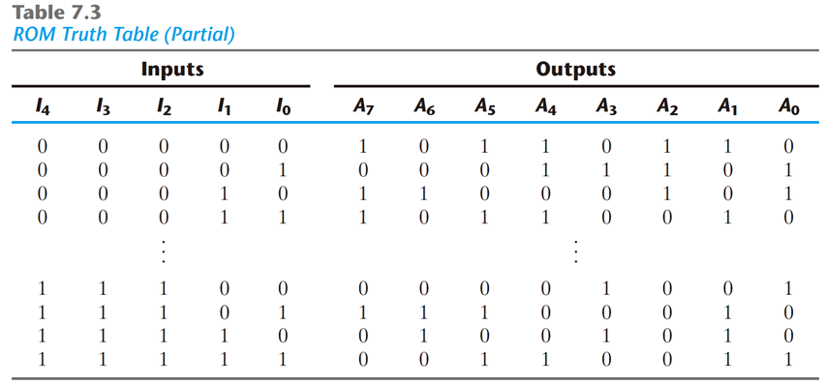
A ROM Example
(address)
(0)
(1)
(2)
(3)
…
(28)
(29)
(30)
(31)
9

Slide 10
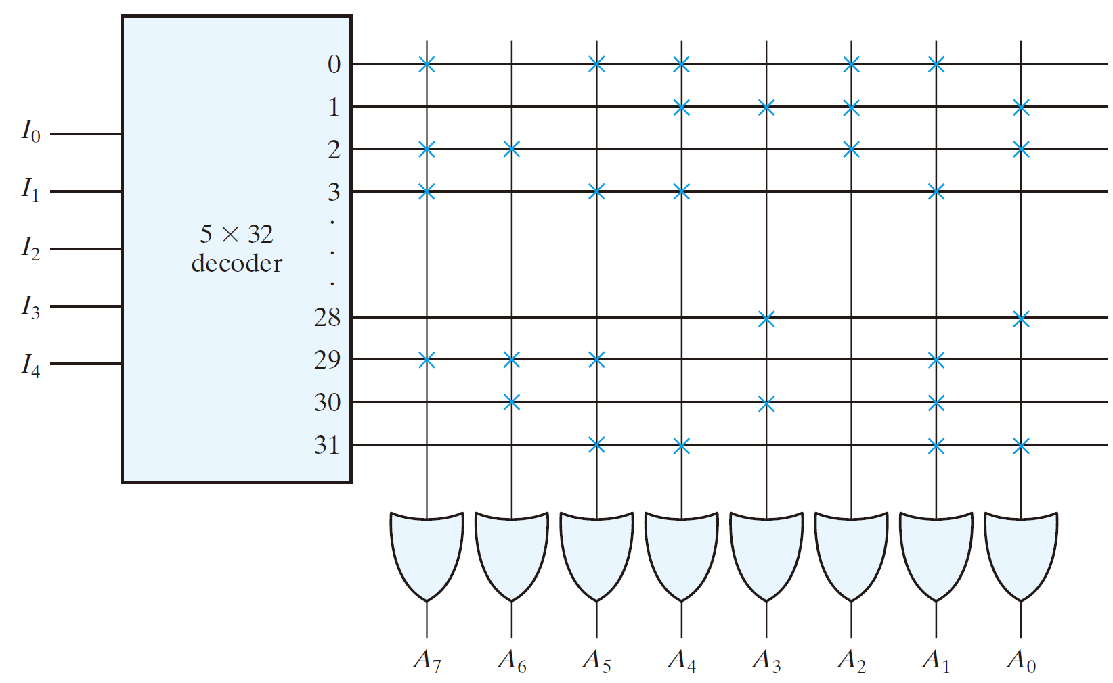
A ROM Example
(From Table 7-3 )
10

Slide 11
Types of ROM
Mask programming ROM
IC manufacturers
is economical only if large quantities
PROM: Programmable ROM
fuses
universal programmer
EPROM: erasable PROM
floating gate
ultraviolet light erasable
EEPROM: electrically erasable PROM
longer time is needed to write
flash ROM
limited times of write operations
11

Slide 12
Random-Access Memory

Slide 13
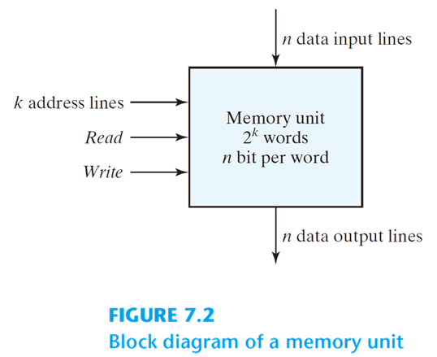
Block Diagram of a Random-Access Memory (RAM)
Data input and output lines carry data
Memory contains 2^{k} words
k address lines select one word out of 2^{k}
Read asserted when data to be transferred to output
Write asserted when data input to be stored
13

Slide 14
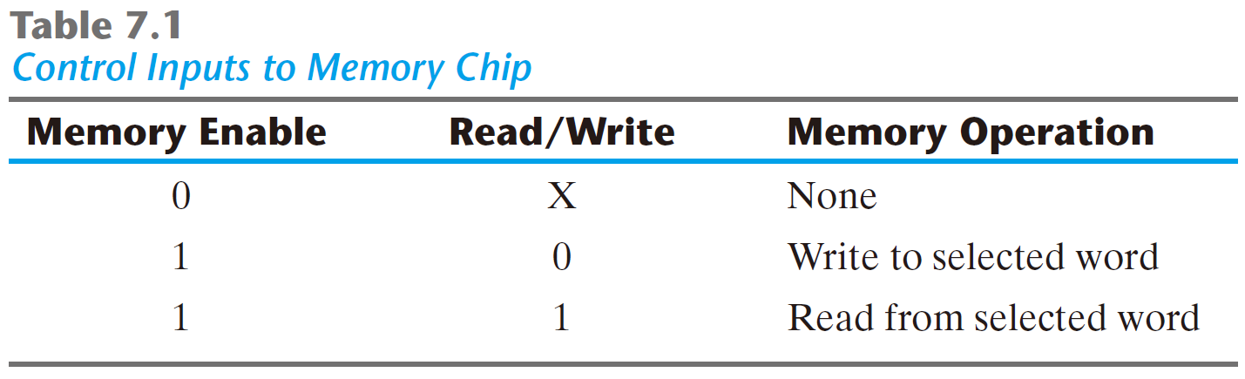
Write and Read Operations
Write operation
Apply the binary address to the address lines
Apply the data bits to the data input lines
Activate the write input
Read operation
Apply the binary address to the address lines
Activate the read input
14

Slide 15
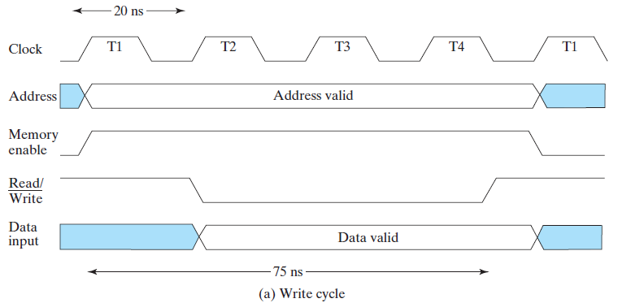
Timing Waveform – Write Operation
The write cycle time is the maximum time from the application of the address to the completion of all internal memory operations required to store a word.
Assume, as an example, that a CPU operates with a clock frequency of 50 MHz, giving a period of 20 ns. A write cycle time is 75 ns.
Apply binary address of word to address lines
Apply data bits to data input lines
Activate write input
15

Slide 16
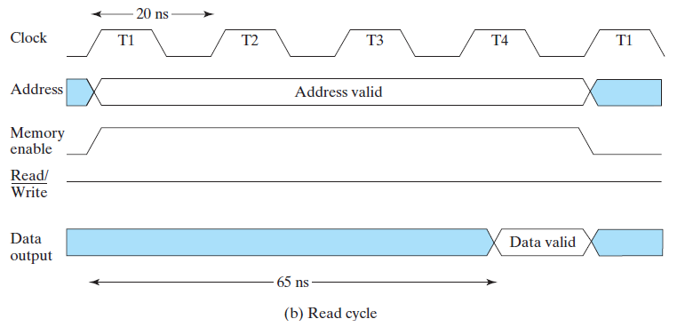
Timing Waveform – Read Operation
The access time of a memory read operation is the maximum time from the application of the address to the appearance of the data at the Data Output.
An access time is 65 ns.
Apply the binary address to the address lines
Activate read input
16

Slide 17
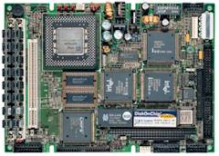
Comments about Memory Access and Timing
Most computers have a central processing unit (CPU)
Processor generates control signals, address, and data
Values stored and then read from RAM
The timing of the system is very important.
Processor provides data for the cycle time on writes
Processor waits for the access time for reads
17

Slide 18
Types of Random Access Memories
Static random access memory (SRAM)
Operates like a collection of latches
Once value is written, it is guaranteed to remain in the memory as long as power is applied
Generally expensive
Used inside processors (like the Pentium)
Dynamic random access memory (DRAM)
Generally, simpler internal design than SRAM
Requires data to be rewritten (refreshed), otherwise data is lost
Often hold larger amount of data than SRAM
Longer access times than SRAM
Used as main memory in computer systems
18

Slide 19
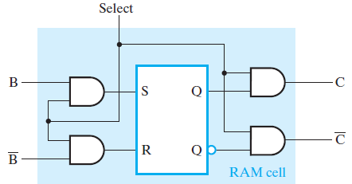
Static RAM Cell
We first show a static RAM cell for storing a single bit and then use the cell in a hierarchy to describe the RAM chip
SR Latch
Select input for control
Dual Rail Data Inputs B and B
Dual Rail Data Outputs C and C
19

Slide 20
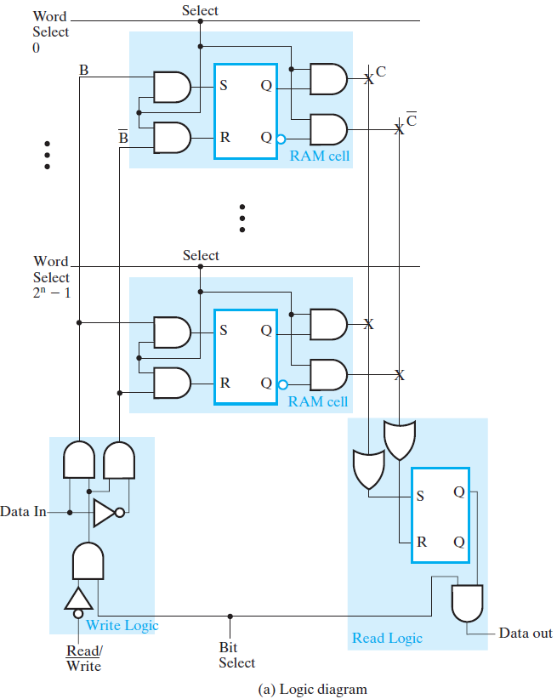
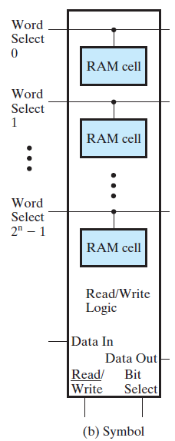
Static RAM Bit Slice
Represents all circuitry that is required for 2^{n} 1-bit words
20

Slide 21
Static RAM Bit Slice
The loading of a cell latch is now controlled by a Word Select input.
If this is 0, then both S and R are 0, and the cell latch contents remain unchanged.
If this is 1, then the value to be loaded into the latch is controlled by two signals B and B from the Write Logic
Read/Write must be 0 and Bit Select must be 1
If Data In is 1, the latch is set to 1
If Data In is 0, the latch is reset to 0, completing the write operation
The Word Select also controls the reading of the RAM cells, using shared Read Logic.
If this is 0, the stored value in the SR latch is prevented by the AND gates from reaching the pair of OR gates in the Read Logic.
If this is 1, the stored value passes through to the OR gates and is captured in the Read Logic SR latch.
If Bit Select is also 1, the captured value appears on the Data Out line of the RAM bit slice.
21

Slide 22
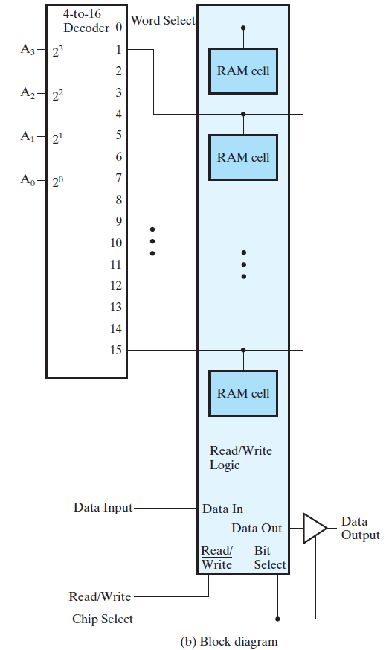
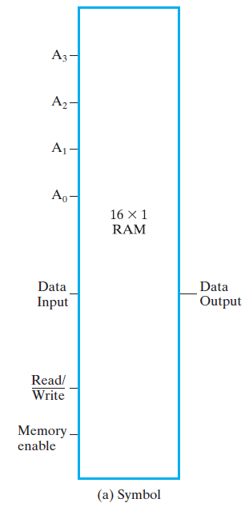
A 16 x 1 RAM chip
The Chip Select at the chip level corresponds to the Memory Enable at the level of a RAM consisting of multiple chips.
22

Slide 23
Cell Arrays and Coincident Selection
Inside a RAM chip, the decoder with k inputs and 2^{k} outputs requires 2^{k} AND gates.
The decoder size and fanouts can be reduced by approximately by using a coincident selection in a 2-dimensional array.
Uses two decoders, one for words and one for bits
Word select becomes Row select
Bit select becomes Column select
23

Slide 24
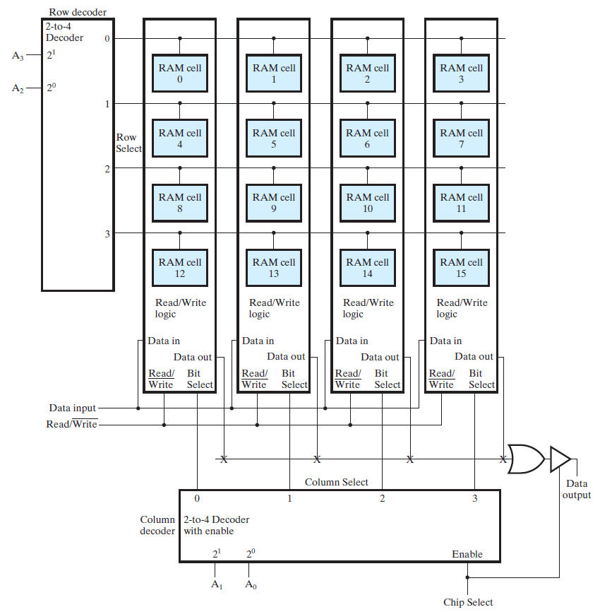
Block Diagram of a 16x1 RAM Using a 4x4 RAM Cell Array
24

Slide 25
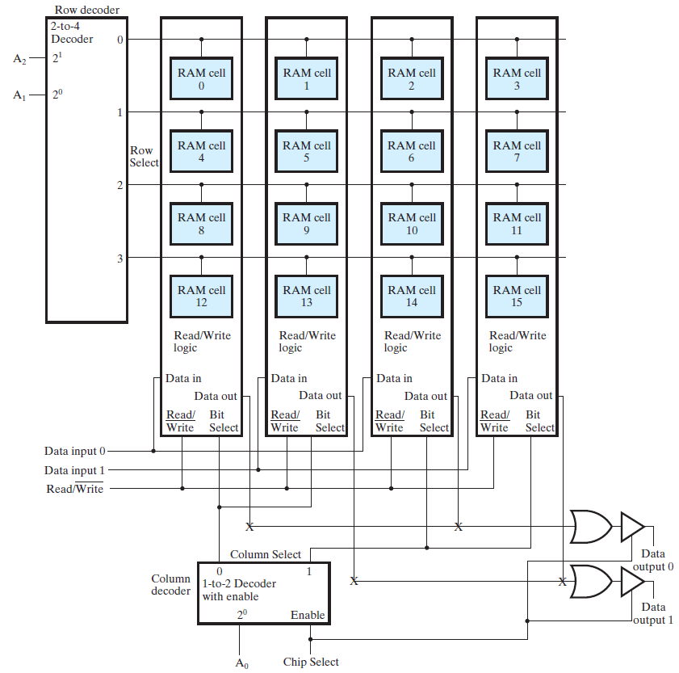
Block Diagram of a 8x2 RAM Using a 4x4 RAM Cell Array
25

Slide 26
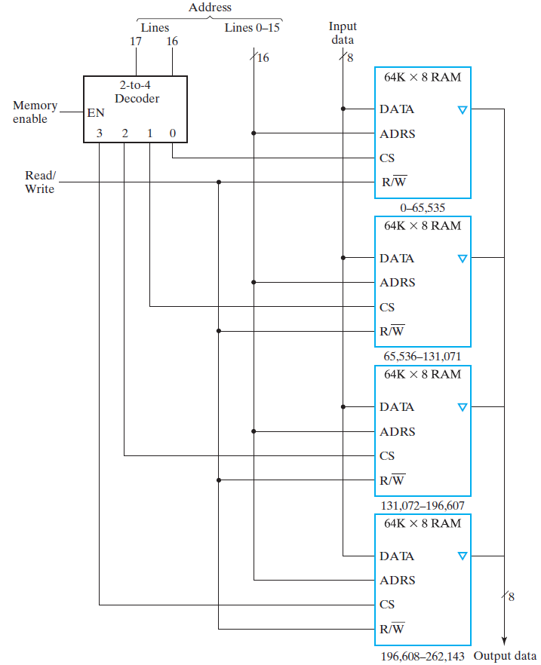
Block Diagram of a 256K x 8 RAM
26

Slide 27
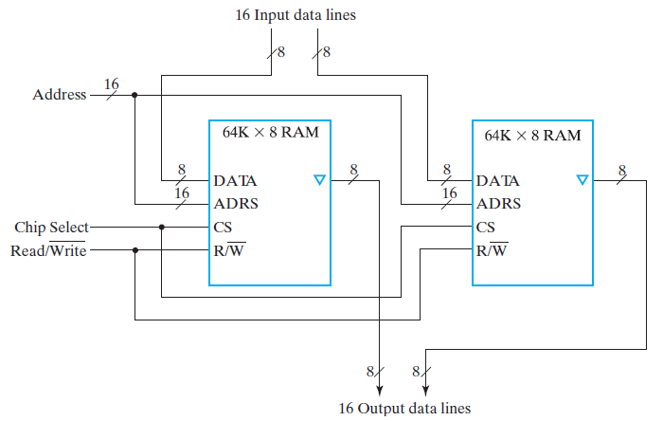
Block Diagram of a 64K x 16 RAM
27

Slide 28
Dynamic RAM (DRAM)
Basic Principle: Storage of information on capacitors.
Charge and discharge of capacitor to change stored value.
Need periodically “refreshed.
Use of transistor as “switch” to:
Store charge
Charge or discharge
28

Slide 29
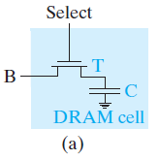
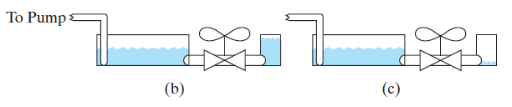
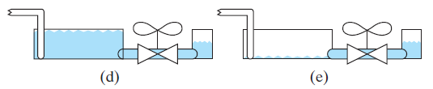
DRAM Cell
Small tank is initially high (1)
Small tank is initially low (0)
Write 1:
Pumps fill up the large tank.
Water flows through the valve,
fill the small storage tank
Write 0:
Pumps empty the large tank.
Water flows through the valve,
empty the small storage tank
29

Slide 30
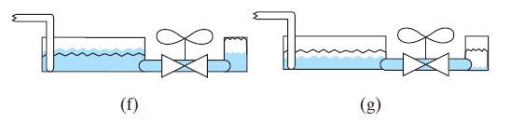
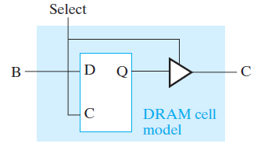
DRAM Cell
Read 1:
Start with a full storage tank.
Large tank at a known intermediate level.
Open the valve, water flows from the small tank to the large tank.
Increasing the level of the water surface in the large tank slightly.
This increase in level is observed as the reading of 1 from the storage tank.
Read 0:
Start with an empty storage tank.
Large tank at a known intermediate level.
Open the valve, water flows from the large tank to the small tank.
Decreasing the level of the water surface in the large tank slightly.
This decrease in level is observed as the reading of 0 from the storage tank.
a logic DRAM cell model, which is a D latch.
30

Slide 31
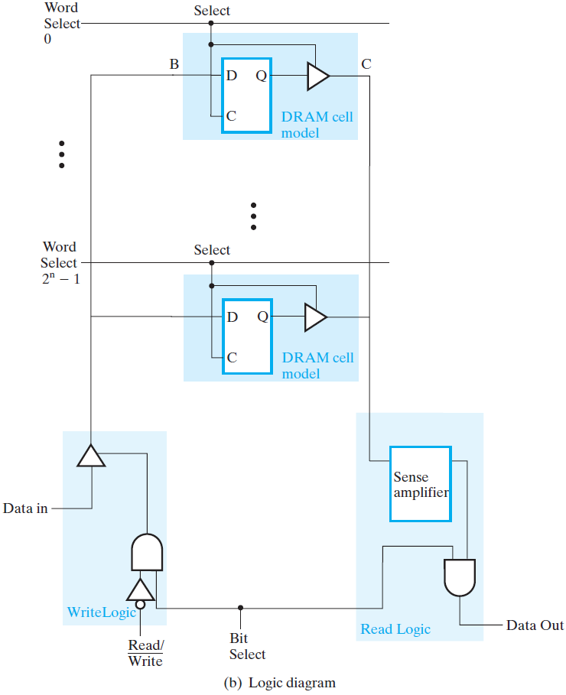
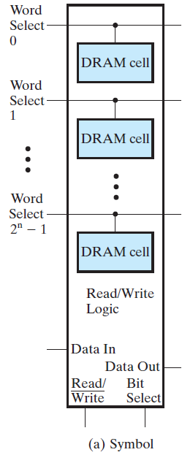
DRAM Bit Slice
31

Slide 32
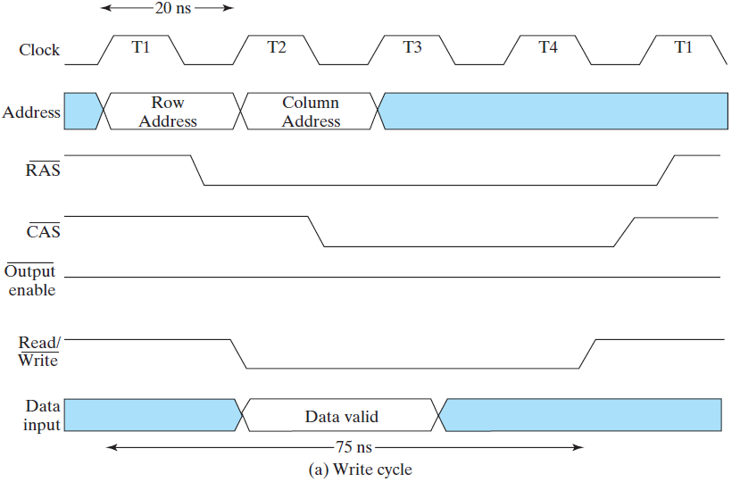
Timing Waveform – Write Operation
The row address is applied, RAS changes from 1 to 0.
The column address is applied, CAS changes from 1 to 0.
The input data with Read/Write = 0 is applied over a time interval similar to that for the column address.
32

Slide 33
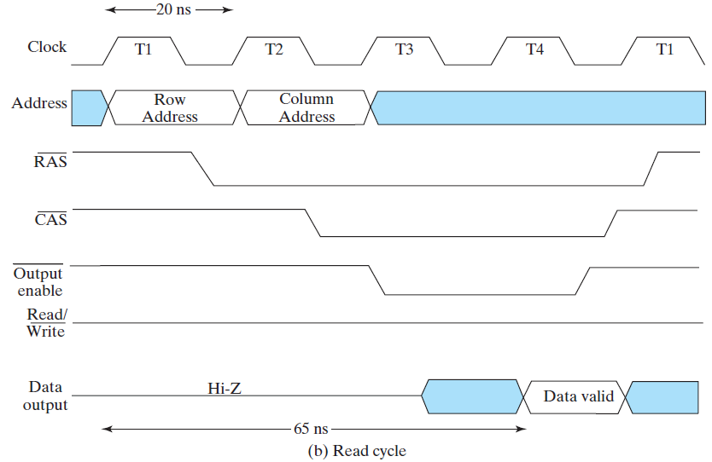
Timing Waveform – Read Operation
The row address is applied, RAS changes from 1 to 0.
The column address is applied, CAS changes from 1 to 0.
The input data with Read/Write = 1 is applied, selected value
is sent to the Data output, which is enabled by Output enable.
33

Slide 34
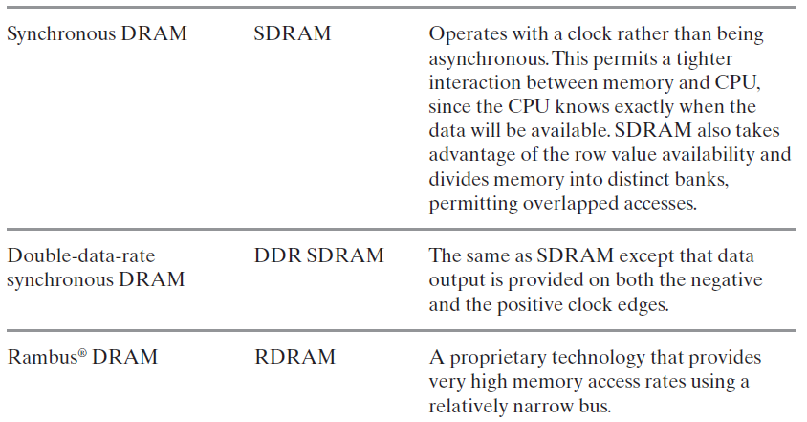
DRAM Types
34

